Slide 1
Welcome to 5th grade Open House
2022-2023
Barton Chapel Elementary School
Dr. L. Carpenter, Principal
Mrs. J. Harris, Assistant Principal

Slide 2
Richmond County School System
Mission Statement
Building a world-class school system through education, collaboration, and innovation.
Vision Statement
The Richmond County School System will create a world-class, globally competitive school system where all students will graduate and are college and career ready.

Slide 3
Introduction To The
Mrs. Michelle Brady-ELA and Science-Room 128
Ms. Tiffany Hill-ELA and Science-Room 133
Mr. Michael Mosley-Math and Social Studies-Room 132
Mr. Daniel Warthen-Math and Social Studies-Room 127
Ms. Tenisha Blair-i-Ready Interventionist
Fifth Grade Team

Slide 4
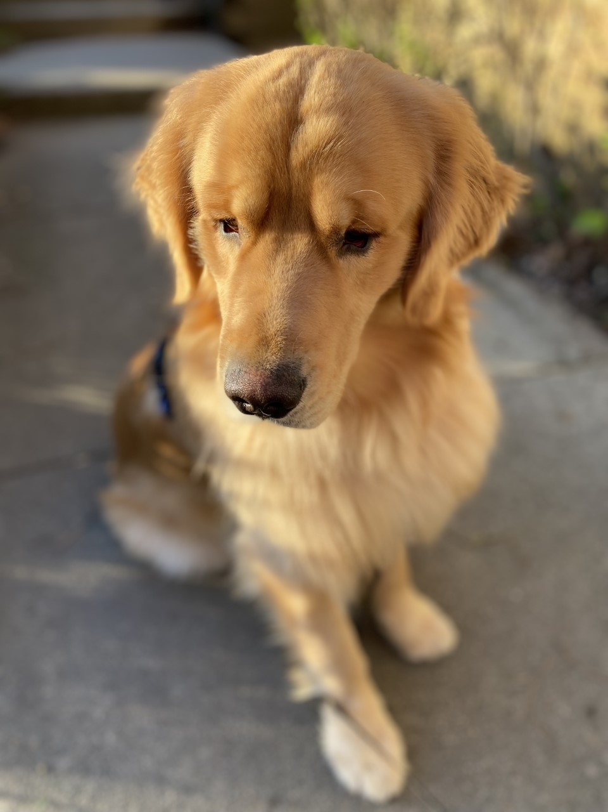
Meet the teacher
Mrs. Michelle brady
I am incredibly excited to be apart of the 5th grade team at BCE. I will be teaching English Language Arts and Science this school year. This will be my 28th year in elementary education. I have been a BCE Roadrunner for 18 years. I currently reside in Richmond County along with Thomas, my husband and Walker my fur baby. In my “me” time I enjoy watching old mystery tv shows, sipping on my favorite drink from my favorite place Starbucks, and playing with my buppy WalkWalk!
Contact Information:
Class Dojo
Bradymi@Richmond.k12.ga.us
Cell: 706-832-2466 Work: 706-796-4955

Slide 5
Daily English Language Arts 90 minutes Routine:
Word Study Routine
Whole Group Routine
Closing Routine
5-10 minutes lesson from the Word Study Guide in Benchmark Literacy
Students will interact with new words.
Students will complete sorting activities and read alouds for fluency in word use.
10-20 minutes-Teacher taught mini lessons on literary or informational reading standards and the aligned writing task.
40-50 minutes-Students will work in small groups during this time. The groups are (1) teacher led small group, (2) personalized learning, and (3) independent group activities in reading and writing.
5-10 minutes-Teacher will allow students to summarize their learning using class discussion, sharing work, or assessment.

Slide 6
Getting Ready for 5th Grade
ELA
Mathematics
Science and Social Studies
Determines the meaning of unknown or multiple meaning words and phrases
Reading, comprehending and writing using informational and literary text.
Order of operations and whole numbers
Adding and subtracting with decimals
Multiplying and dividing with decimals
Adding, subtracting, multiplying and dividing fractions
Working with 2D figures
Working with volume and measurement
Geometry and the coordinate plane
Science Overview
Cells and microorganisms
Energy Transfer through electricity and magnetism
Dynamics of classification
Earth and changes over time
Physical and chemical changes
Social Studies Overview
Citizenship
The Changing Nation
World War 1 and the 1920s

Slide 7
5th Grade Beep Expectations
BE on time and ready for the BCE learning experience!!!
Always EXERCISE responsibility!
ENGAGE in learning individually and collaboratively with peers.
PRACTICE being kind to yourself and others.

Slide 8
Daily classroom expectations
Verbal guidance to allow students to self correct.
Class Dojo notification
Parent teacher contact to draft a behavior plan

Slide 9
Daily Classroom Expectations
Guidance referral-Ms. Brown, Counselor
Administrative assistance-Dr. Carpenter, Principal and/or Ms. Harris, Assistant Principal

Slide 10
Fifth Grade assessments
1. i-Ready Diagnostic: Reading and Math
  Administered in the Fall, Winter and Spring
  Growth Monitoring administered monthly to track growth in reading and math
  Instructional lessons in reading and math are completed daily
  2. Content Mastery Assessment (CMAs) RCSS unit assessments for English Language Arts, Math, Science and Social Studies
  3. Georgia Milestones Assessment-administered in the spring in Reading, Writing, Math, and Science (5th Grade)
  4. Weekly classroom assessments selected by the teacher to monitor progress on weekly Georgia Standards of Excellence

Slide 11
5th Grade
8 Glue Sticks
Index cards
Sheet protectors
Dividers
Plastic pencil case
6-70 Sheets notebook
Book bag
1.5in. 3 ring binder with dividers
lead pencils
Covered hand held pencil sharpener
Highlighters (5 different colors)
Colored pencils
4 composition notebooks(2 orange and 2 greens)
Notebook paper (wide or college rule)
Headphones

Slide 12
Daily Reminders
SCHOOL DAY: 8:20-3:05
Attendance is critical so please schedule appointments before or after school if possible.
HOMEWORK is assigned and required Monday thru Thursday. Homework is posted on a homework calendar and class web page.
TRANSPORTATION: If you desire to change your child’s transportation it must be in writing. Emergency messages may also be sent on Class Dojo.
COMMUNICATION: Infinite Campus Parent Portal and Class Dojo are you stay in the know tools. Mrs Tammy Barnes will assist with IC Parent Portal

